Slide 1

BIOL 252: MICROBIAL ECOLOGY 2019/2020

Slide 2
Recommended texts for further reading
Introduction to Microbiology – Ingraham and Ingraham
MICROBIOLOGY - Prescott, Harley and Klein
Fundamentals of Microbiology – Frobisher
Essential Microbiology – S. Hogg
Any good Microbiology book
Authentic Microbiology journals

Slide 3
Assessment Requirements
Punctuality, Attendance
Presentations (Group)
Assignments (Individual and Group)
Short Quizzes – Un/announced
Mid Semester Examination**
Practical Assignments – Weekly
End of Semester Examination 70%
Continuous Assessment 30%

Slide 4
Course Outline
Natural Microbial Environments---done
Microorganisms of Extreme environments--done
Strategies for survival---done
Some important diseases ---- done
Water and excreta-related diseases
Biofilms
Water Treatment
Sewage Treatment

Slide 5
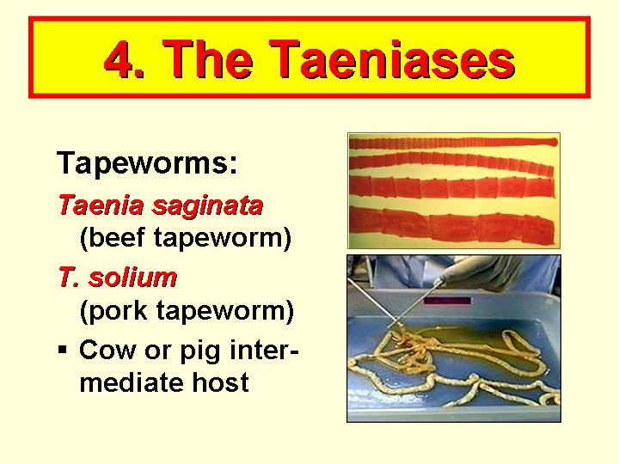

Slide 6
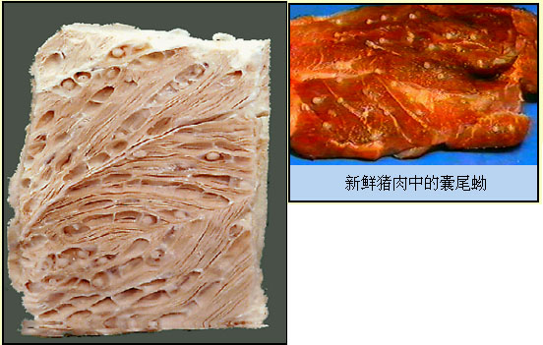
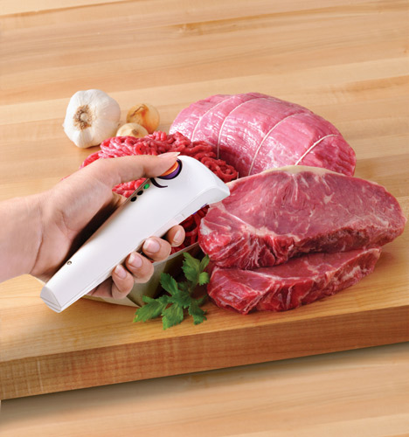
Mode of transmission
Uncooked or infected meat such as:
-Fish (fish tapeworm)
-Beef (beef tapeworm)
-Pork (pork tapeworm)
Live in intestines
Symptoms
Usually absent
May include abdominal pain, fatigue, weight loss, diarrhea

Slide 7
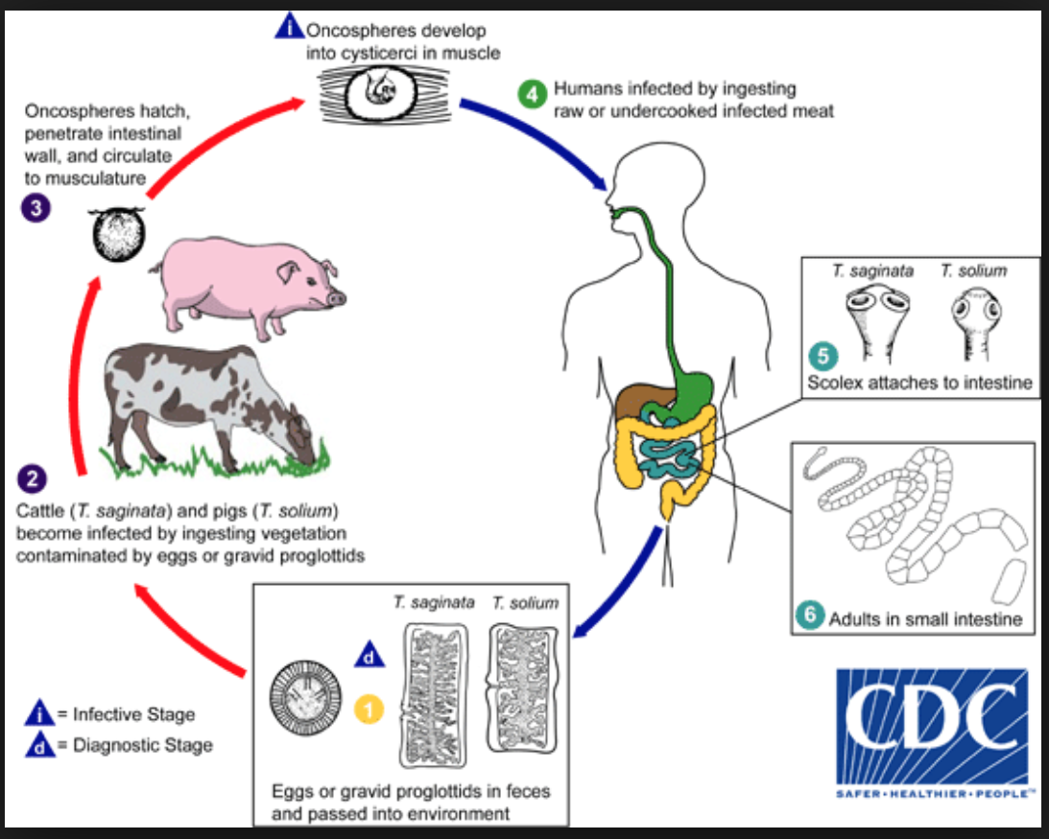
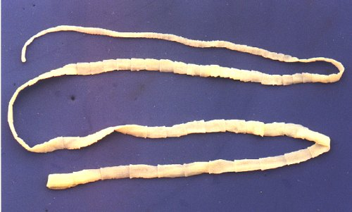
Life cycle
Hermaphrodites

Slide 8
Key factors for preventing Taeniases
Consume well-cooked meat and fish

Slide 9
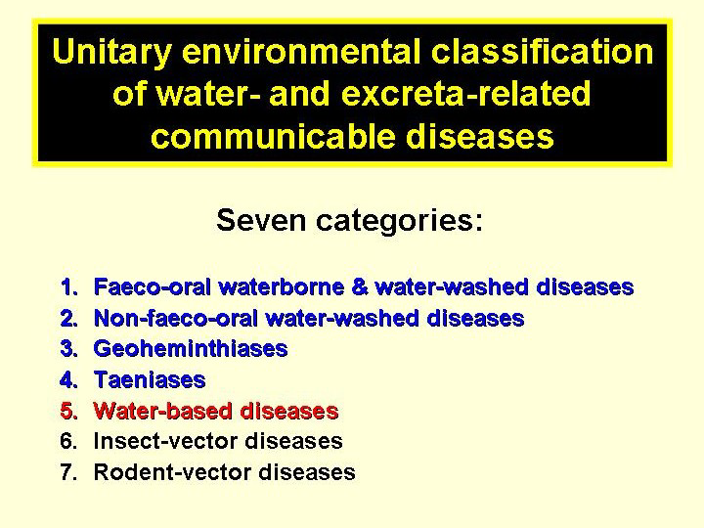

Slide 10
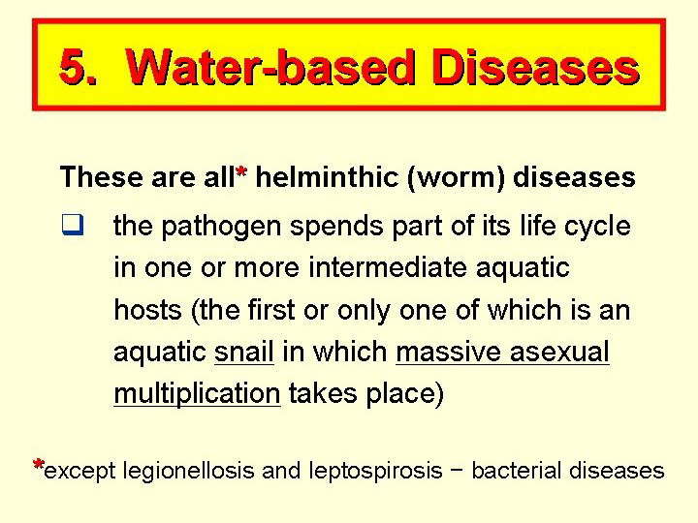

Slide 11
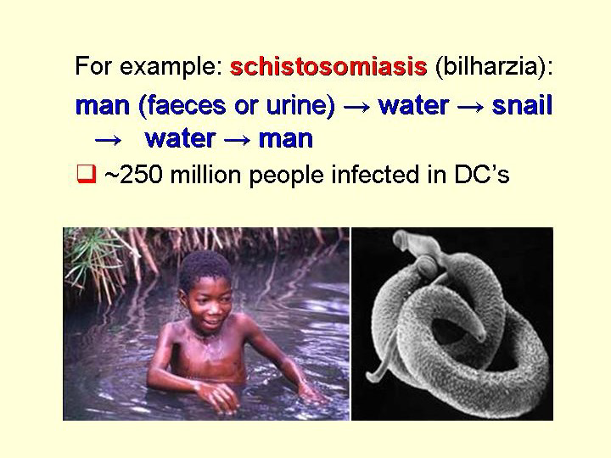

Slide 12
Infections by Schistosoma haematobium, S. mansoni are frequent than those by S. japonicum and S. intercalatum
Clinical:
Each species give rise to specific clinical form, it depends on the parasite load
Schistosomiases (urinary): S. haematobium signs: haematuria, frequent and painful micturition evolution to fibrosis urethral.
Schistosomiases (intestinal): S. mansoni signs: bloody diarrhoea , abdominal pain, nauseas, vomit and it evolution liver fibrosis
TRANSMISSION: By contact with the parasite when bathing or swimming in contaminated water.

Slide 13
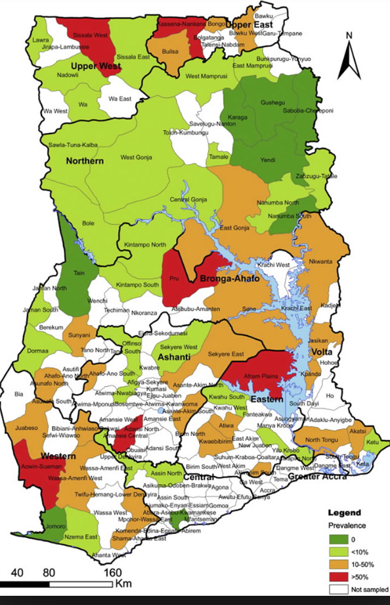
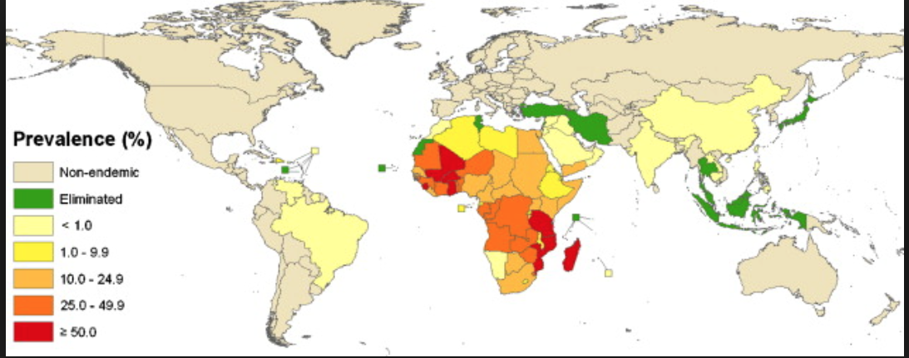
Distribution

Slide 14
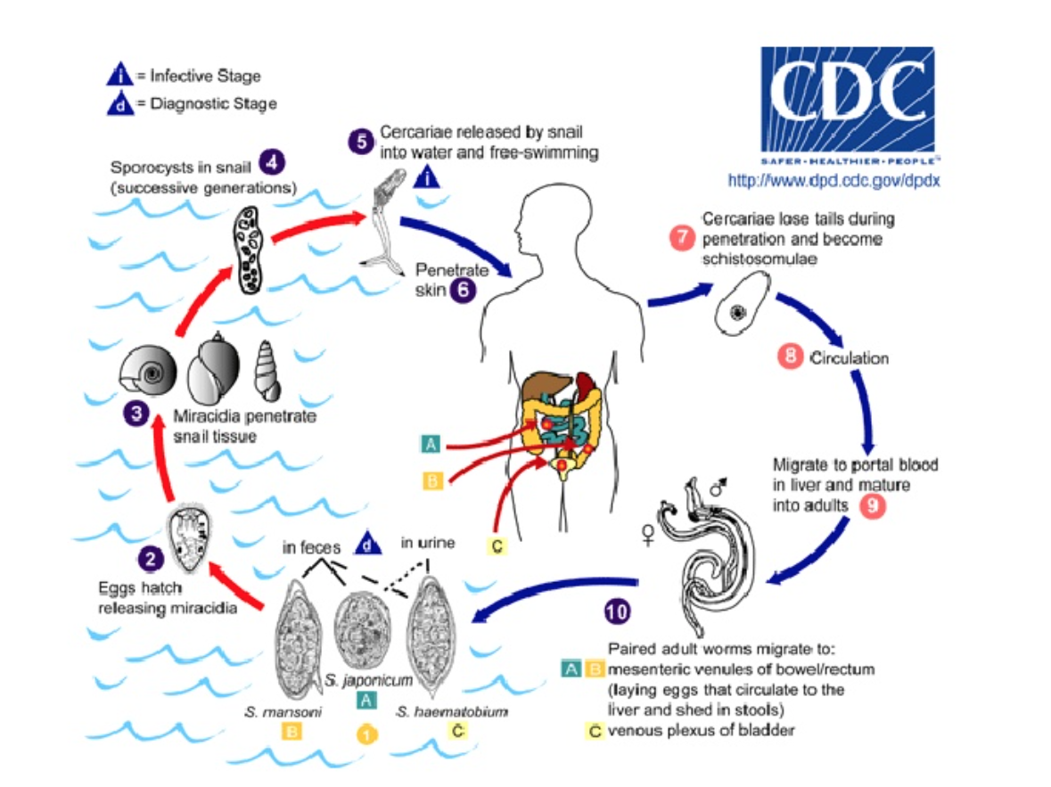
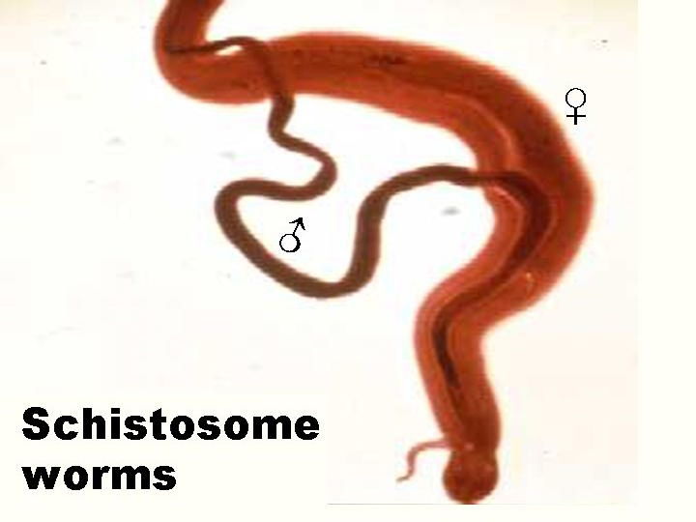
Life cycle

Slide 15
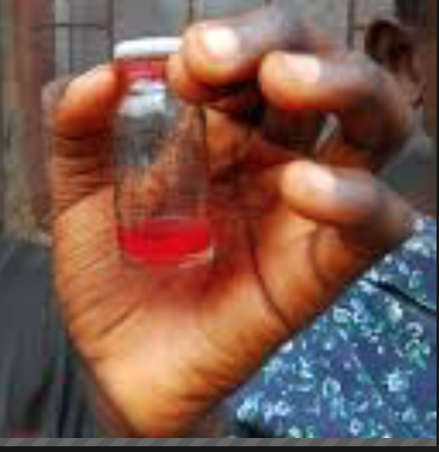
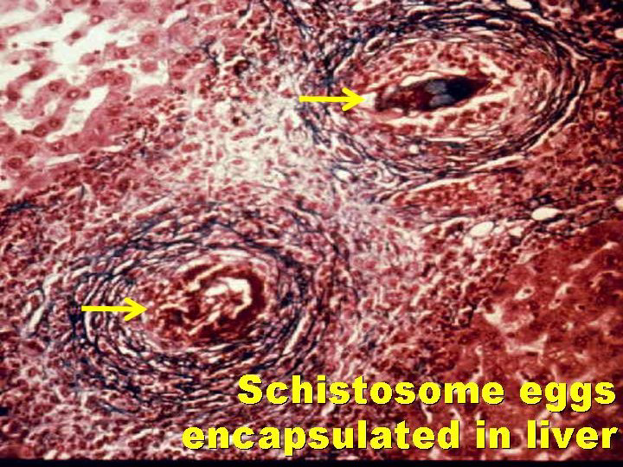
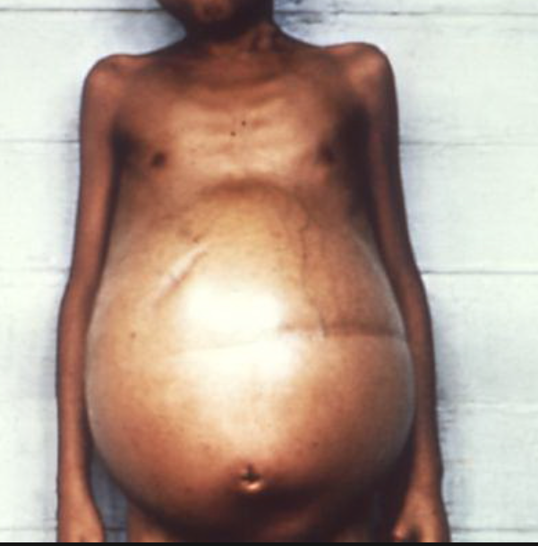
Presentations

Slide 16
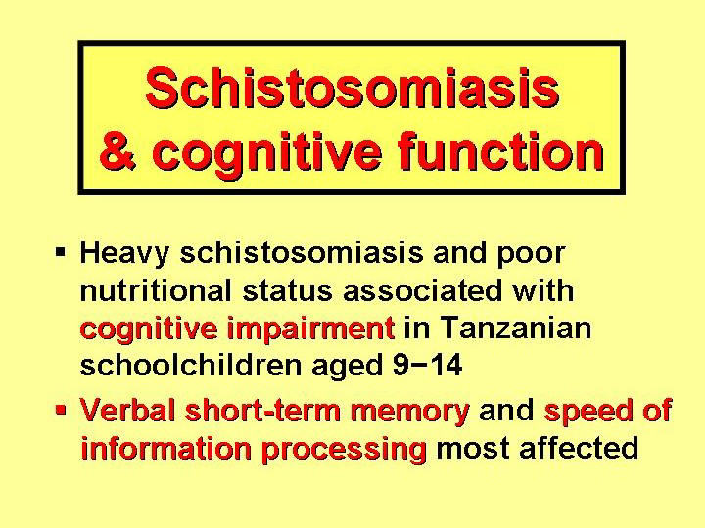

Slide 17
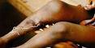
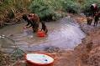
Key factors for preventing water-based diseases
Safe water (drinking and domestic) supply
Adequate drainage of stagnant waters
Control snails
MDAs

Slide 18
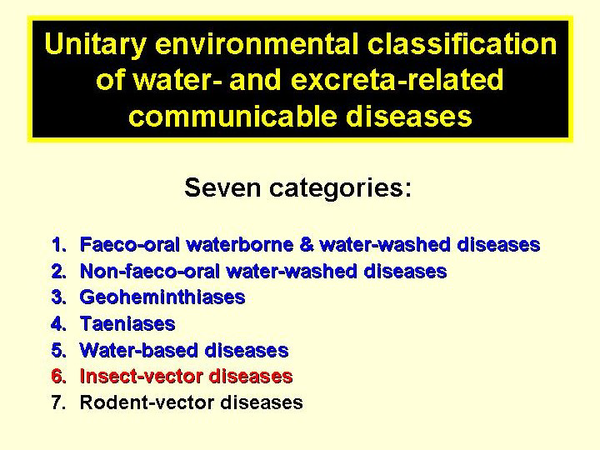

Slide 19
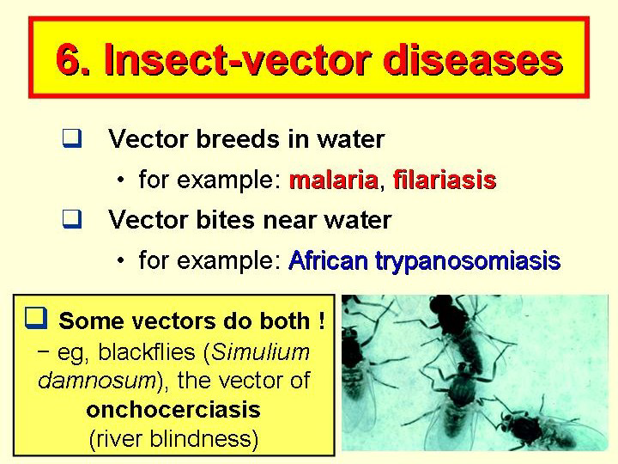

Slide 20
Insect vectors
Transmission mechanisms
Biting by mosquitoes, flies.
Transmitted by mosquitoes and flies
Bite near water
Breed in water
Dirty environment
Malaria, Dengue, sleeping sickness, Filariasis, yellow fever.

Slide 21
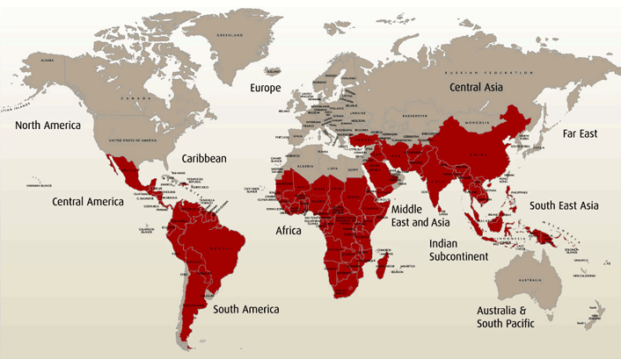
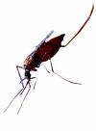
Malaria
Pathogen: Plasmodium falciparum, vivax, malariae and ovale (Parasite)
Vector: Mosquito Anopheles female (Anopheles gambiae complex)
Clinical:
Painful muscles and joints, high fever with chills, headache, diarrhoea and vomiting, coma, death, anaemia
Stagnant waters are the breeding place.

Slide 22
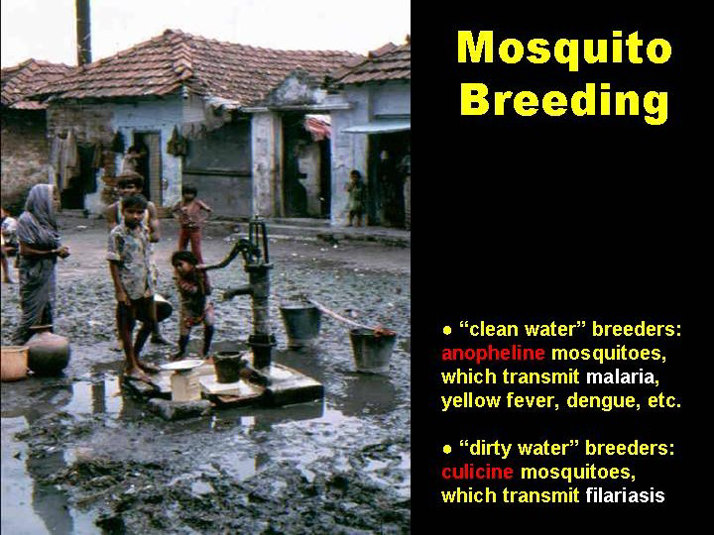

Slide 23
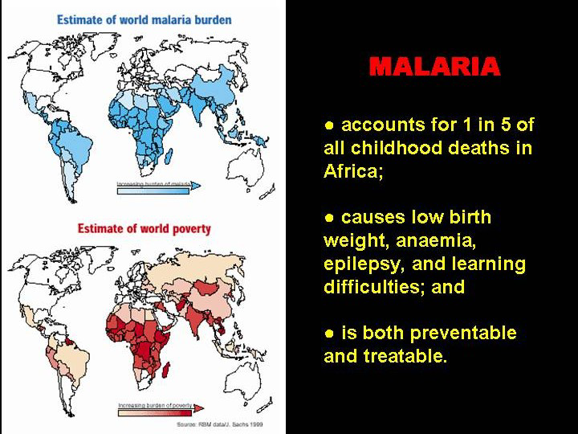

Slide 24
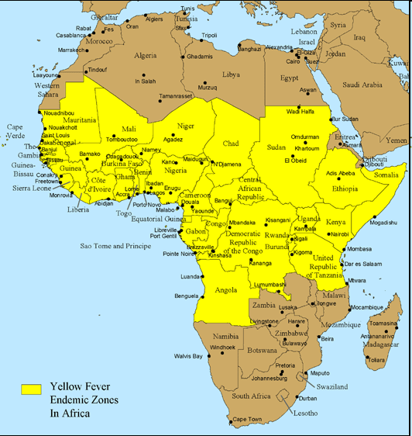
Yellow fever
Pathogen: Virus (Flaviviridiae)
Vector: Aedes aegypti
Clinical:
Fever, headache, myalgia, nausea, red eyes, jaundice.
Breeds in stagnant waters. Only bites during daylight.

Slide 25
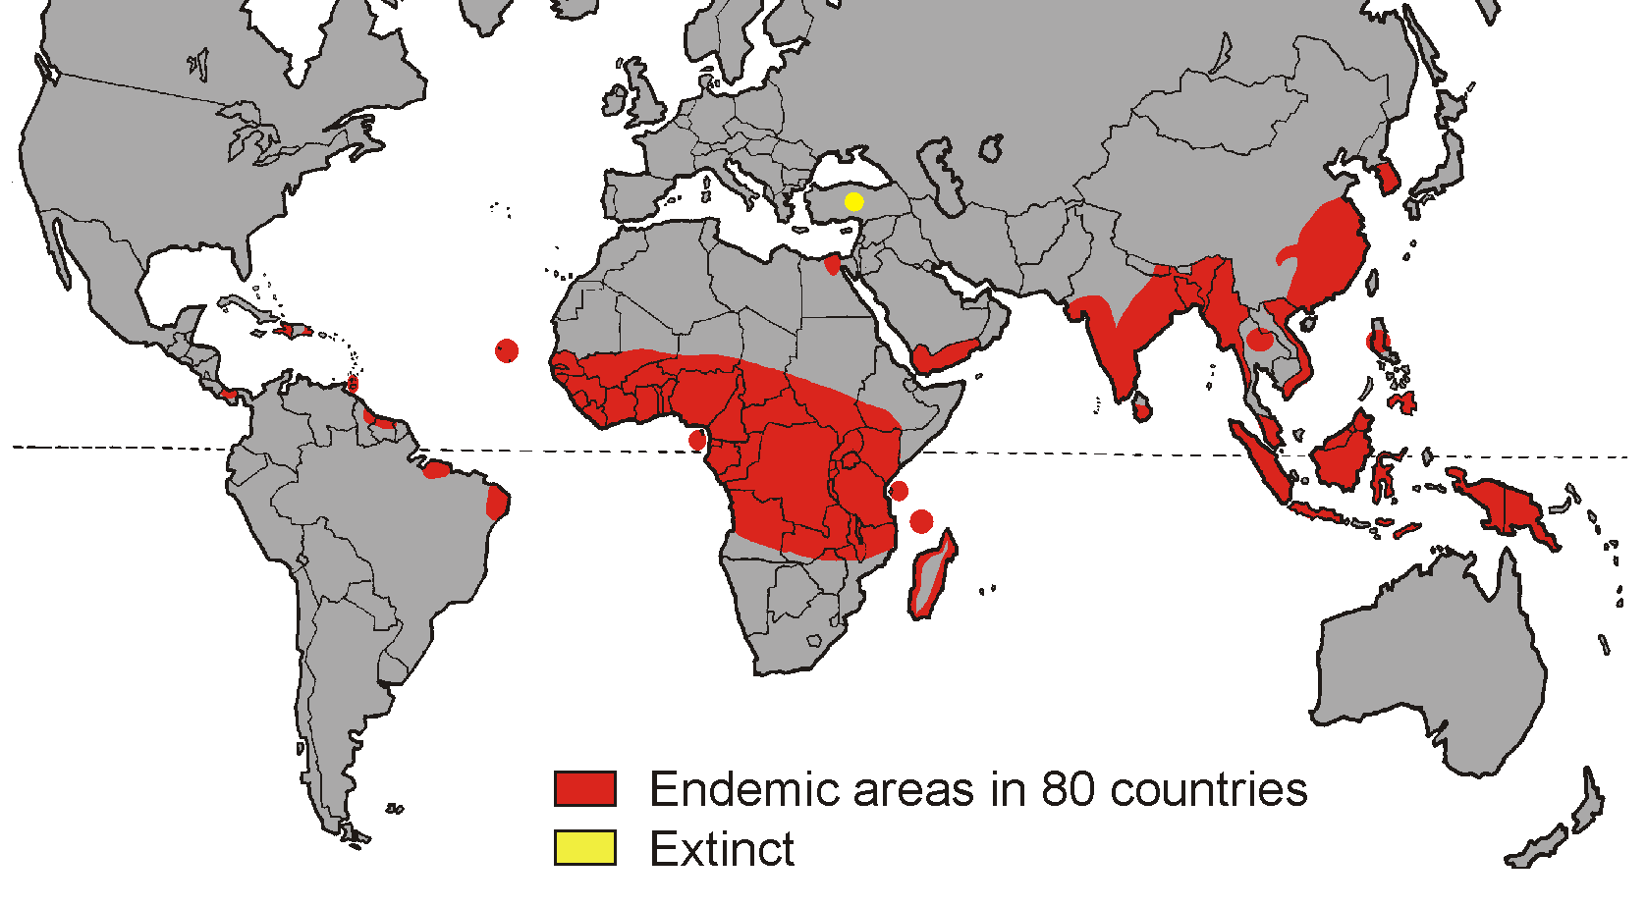
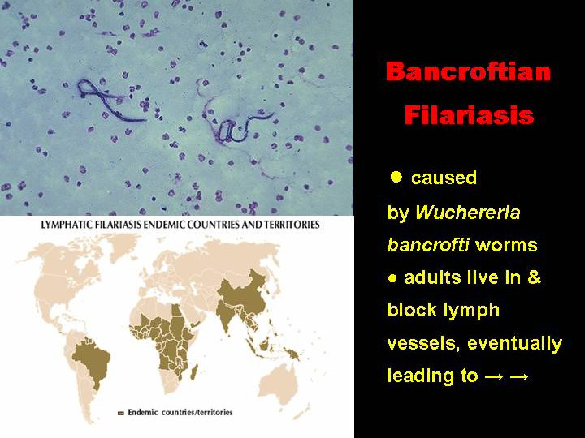
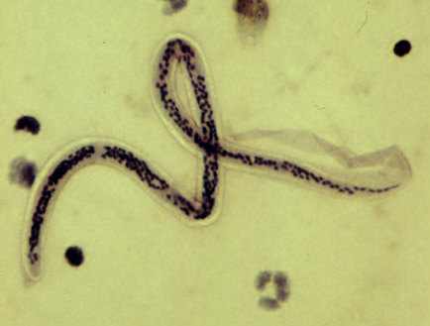
Lymphatic/Bancroftian Filariasis

Slide 26
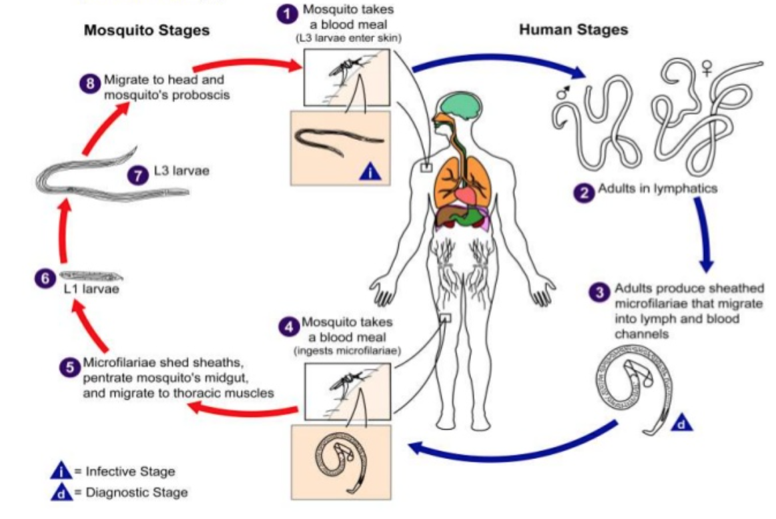
Life cycle

Slide 27
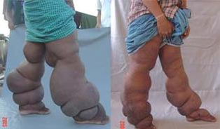
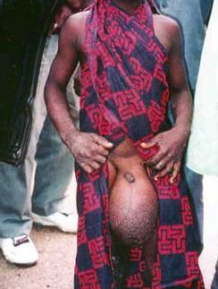
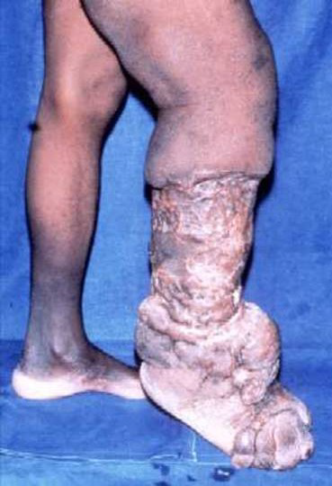
Extreme clinical presentation

Slide 28
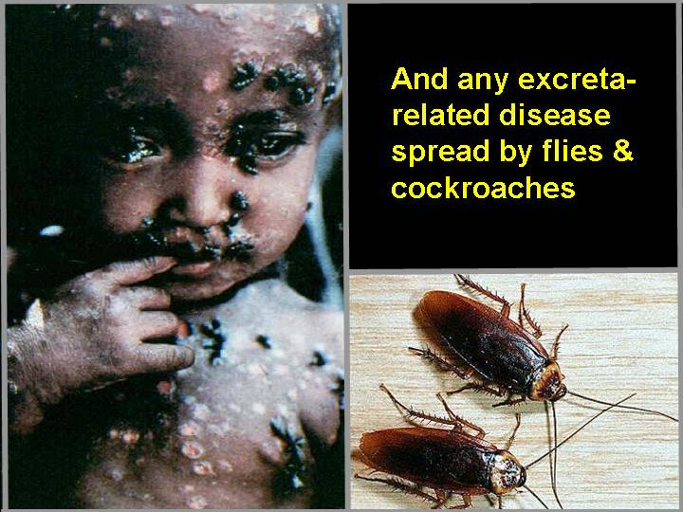
Other insect vector-borne diseases
Trypanosomiasis - spread by Tsetseflies
Encephalitis - Japanese encephalitis – Culex (Mosquitoes)
Onchocerciasis – Black fly
Dengue - Aedes aegypti (Mosquitoes)

Slide 29
Key factors for preventing Insect vector diseases
Adequate drainage of stagnant water
Disposal of waste water
Vector control

Slide 30
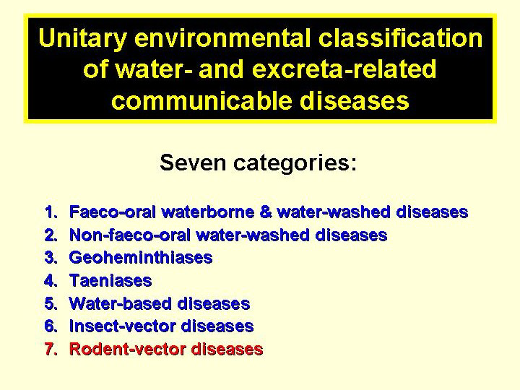

Slide 31
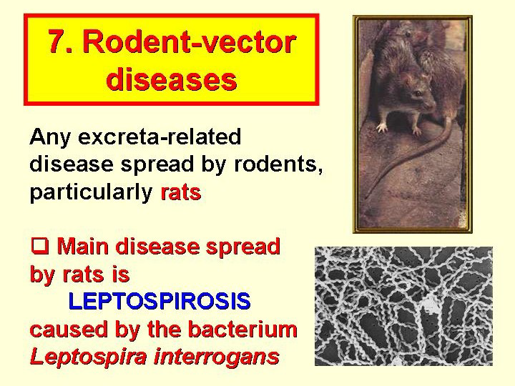
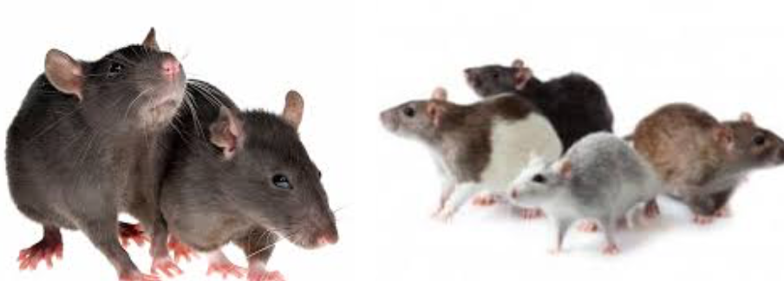

Slide 32
Diseases transmitted by rodents
Hantavirus Pulmonary Syndrome
Lassa fever
Plague
Rat-Bite Fever
Salmonellosis
Tularemia
Hemorrhagic Fever with Renal Syndrome
Leptospirosis

Slide 33
Bacterial disease that affects humans and animals
Humans become infected through contact with water, food or soil containing urine from rats
Occurs when swallowing contaminated food or water (vector)

Slide 34
Prevention and Control
Keep rodent problems (rats, mice) under control.
Wear protective clothing, especially footwear, if you must wade in flood waters or other areas that might be contaminated.
Avoid contact with environments contaminated with animal urine.

Slide 35
BIOFILMS

Slide 36
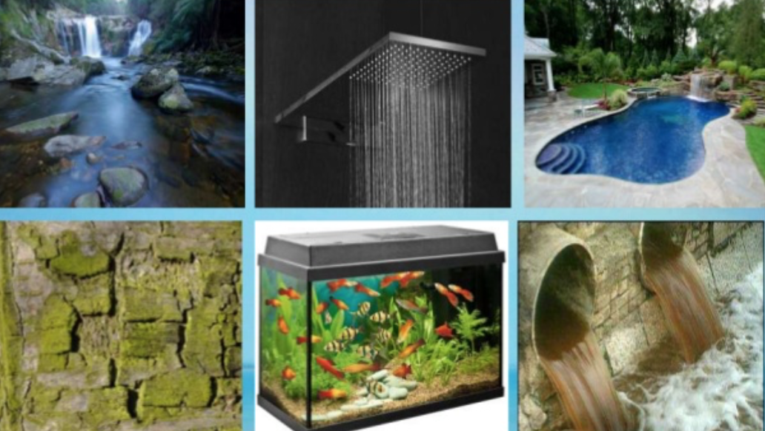
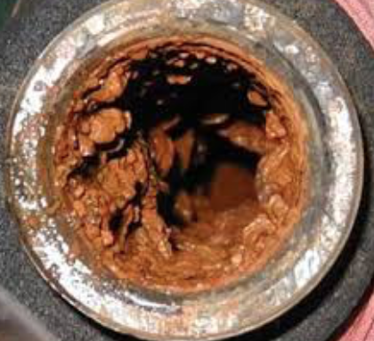
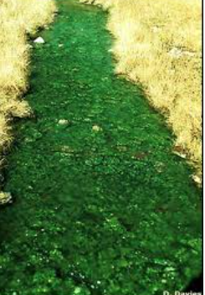
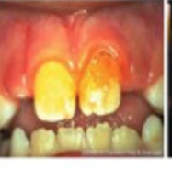
Biofilms

Slide 37
Biofilms
Slimy aggregates of microorganisms in which cells are stuck to each other and/or to a surface.
They may form on living or non-living surfaces (rocks, leaves, water.)
Complex aggregation of microorganisms often seen adhering to the surface of water.
May initially consist of one bacteria type but later contain several bacteria.
May include bacteria, protozoa, fungi, archaea and algae.

Slide 38
Biofilms provide:
Nutrients for pathogens
Microhabitats for growth
Protection from biocides (increased resistance to detergents and antibiotics) such as chlorine and sunlight.

Slide 39
Mechanism of biofilm formation
The formation of biofilm begins when free-floating microorganisms begin to pack themselves loosely together and attach to the surfaces through weak but reversible van der Waal’s forces.
Over time, they are able to attach permanently (become irreversible) by producing extracellular polysaccharide or in some cases by means of specialised structures termed holdfasts or other cell adhesion structures like Pili, flagella and fimbriae.

Slide 40
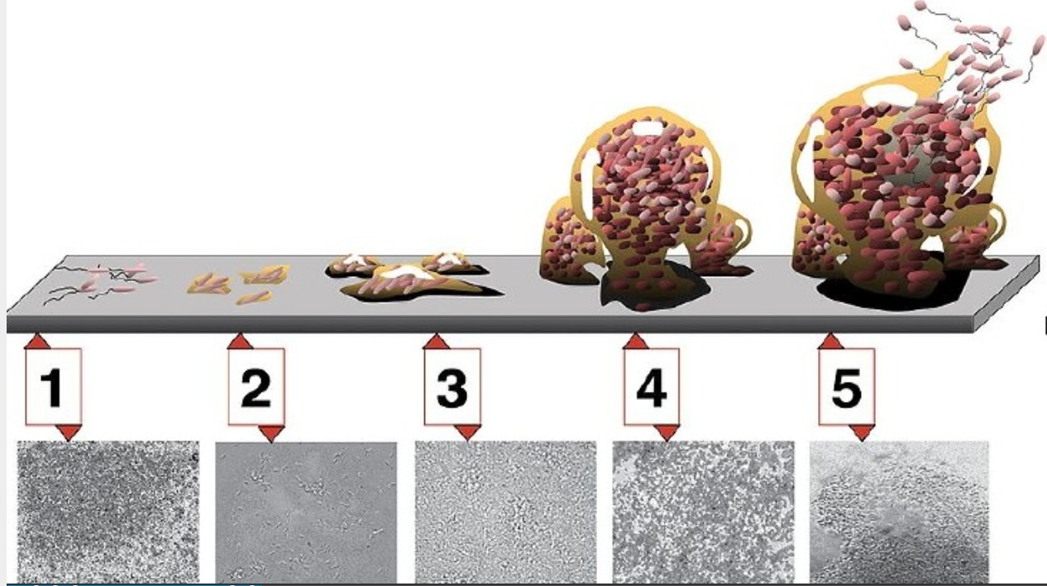
Steps in Biofilm Development (5 stages)
Stage 1 : Initial attachment;
Stage 2 : Irreversible attachment;
Stage 3 : Maturation I;
Stage 4 : Maturation II;
Stage 5 : Dispersion

Slide 41
Initial attachment: Aided by weak reversible van der Waals interactions between the cell surface and the substratum.
Irreversible attachment: Development of micro-colonies which is promoted by the growth and division of the first attached cells
Maturation I: Micro-colonies enlarge to form the first layer of cells covering the surface
Maturation II: Multiple layers pile up and form a mature biofilm indicated by the presence of macro-colonies surrounded by water channels
Dispersion: They spread and colonize other niches

Slide 42
Biofilm structure
Thickness of biofilms depend on:
Nutrient load of the surface
Adsorptive surface
Type of microbial community attached
Fluid temperature
Fluid velocity

Slide 43
Advantages of the “Biofilm mode of life”
Provide defense
Physical forces
Phagocytosis
Penetration of antimicrobials
Provide favorable micro-niches
Can attach to nutrient rich surfaces
Can attach to surface in flowing systems
Fixes bacteria to where nutrients are either in abundance or replenished

Slide 44
Advantages of the “Biofilm mode of life”
Allow microbes to live in close proximity
Facilitates communication and cooperation
Can result in genetic exchange
Nature’s default
More than 99% of all microorganisms on earth prefer to live in biofilms

Slide 45
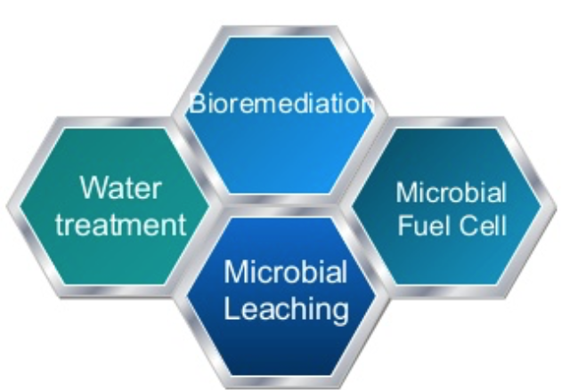
Economic importance of Biofilms Beneficial Biofilms
Recycling of elements vital to life.
These live in biofilm colonies on surfaces

Slide 46
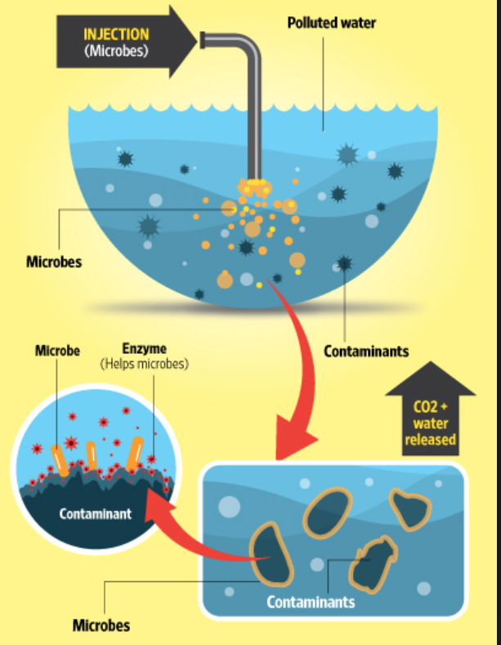
Bioremediation
The Microbes ‘eat up’ contaminants such as oil and organic matter

Slide 47
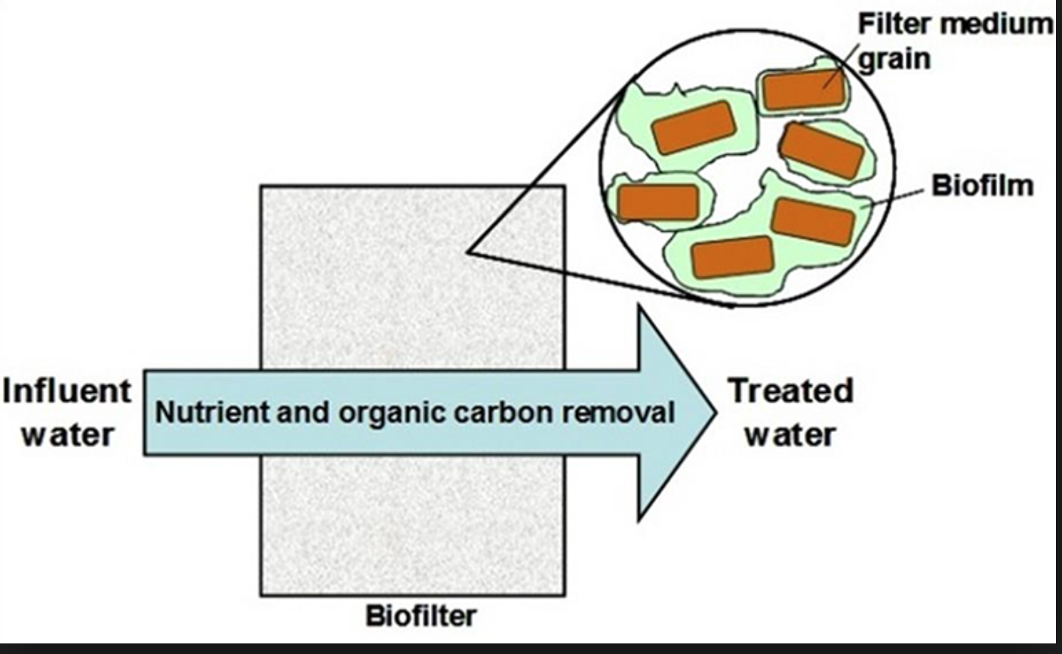
Water Treatment

Slide 48
Treatment of wastewater
Biological treatment of wastewater could be improved by:
enhancing the production of flocculating biopolymers
improving the oxygen scavenging ability of beneficial floc-forming bacteria, and
using immobilized cells that can recover toxic metals from wastewater.

Slide 49
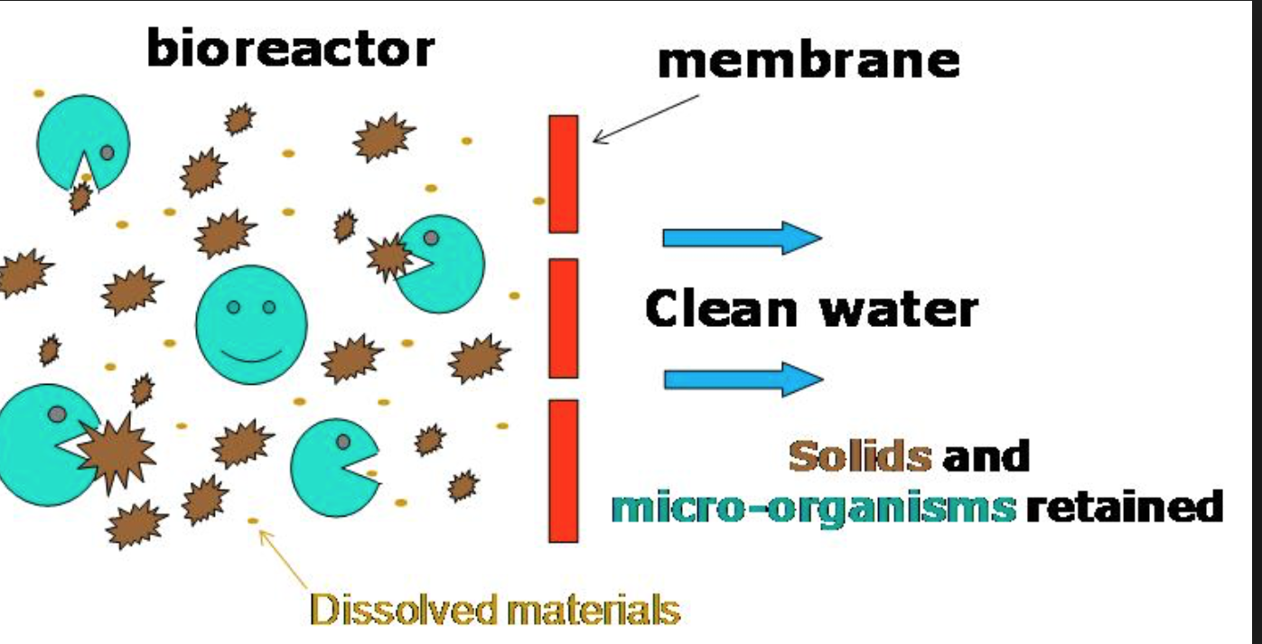
Anaerobic reactor (Bioreactor)
The bioreactor contains a series of plastic hollow particle-like carriers on which a biofilm grows rapidly.
The biofilm causes contaminants to decompose.

Slide 50
Anaerobic reactor
The simplest anaerobic reactor is a septic tank, which separates domestic waste into a settling solid phase, a liquid effluent and floating scum layer
In a completely mixed reaction, the minimum allowable time that solids must remain in a system is determined by the growth rate of methanogens which have a minimum doubling time of 3.3 days at 35ºC.

Slide 51
Anaerobic reactor
The incorporation of both aerobic and anaerobic degradation in the same bioreactor would require that the thickness of the biofilm be maintained such that the internal surfaces are anaerobic while the outer layer remains aerobic.

Slide 52
Anaerobic reactor
Biofilms could facilitate nitrogen removal by promoting denitrification within the anaerobic zone and, nitrification on the aerobic surface.
A microhabitat that possesses a range of redox potentials may also facilitate the breakdown of certain halogenated xenobiotics (e.g., DDT).

Slide 53
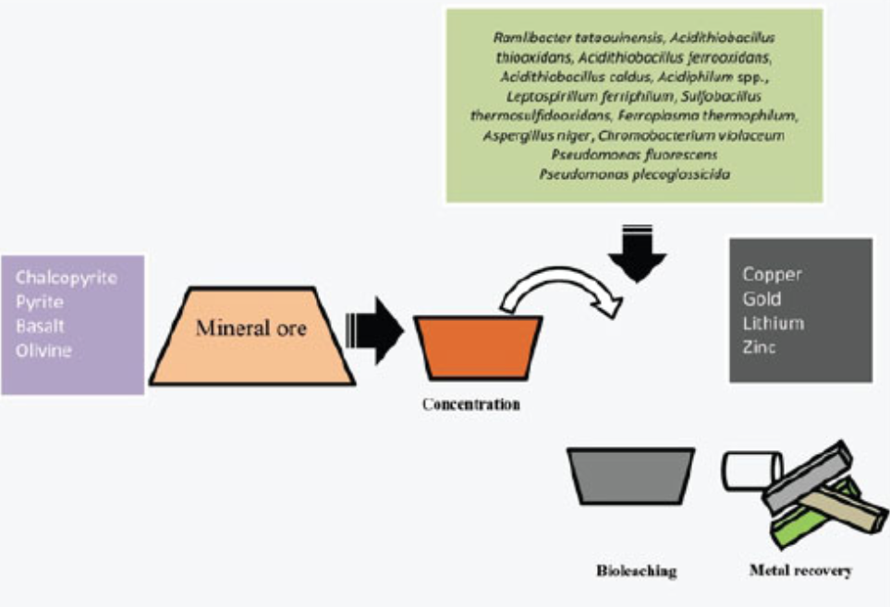
Microbial leaching - Bioleaching
Process of metal extraction from low grade ore and mineral concentrate by the use of microorganisms
Works by specific bacteria ‘eating’ the metal out of ore

Slide 54
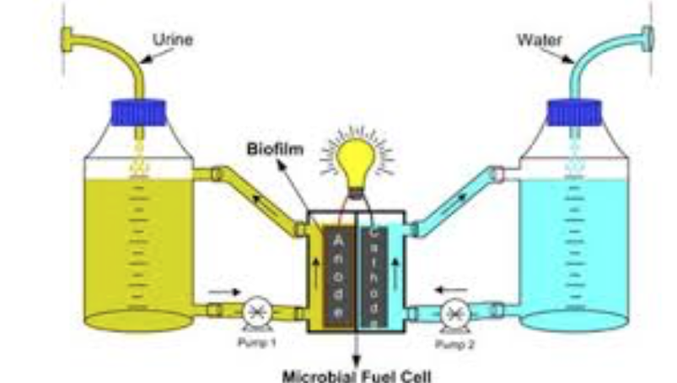
Microbial fuel cell - MFC
MFC: A bio-electrochemical system that drives an electric current by using bacteria and mimicking bacterial interactions found in nature.

Slide 55
Other Usefulness
Use of bacteria and their products in wastewater treatment, bio-extraction and mining practices.
The mining industry has exploited the ability of certain bacteria to accumulate metals intracellularly, particularly in the management of effluent treatment lagoons.
Extracellular interactions between bacteria and metals are probably of greater importance to the integrity and ecology of the water distribution system.

Slide 56
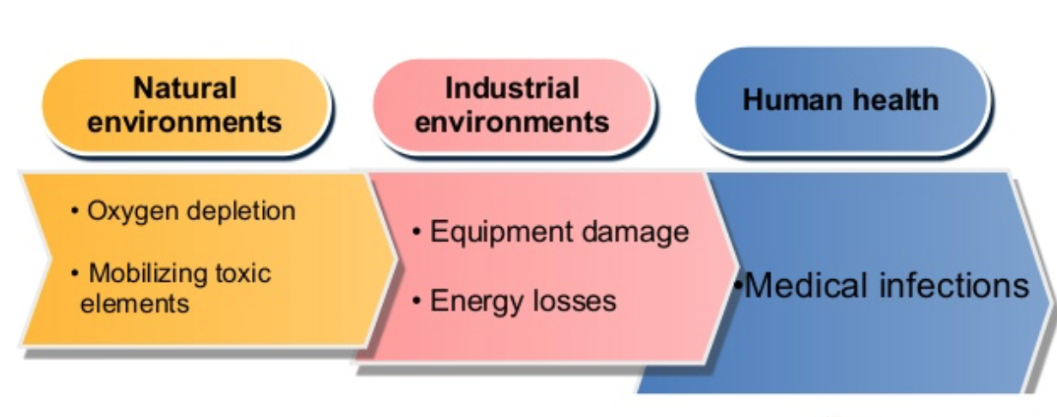
Negative parts - Disadvantages

Slide 57
In natural environments….......
Biofilms grow virtually everywhere
Moisture
Nutrients
Surface
Produce toxic alga blooms
Create O₂ depleting zones in lakes, rivers and coastal environments

Slide 58
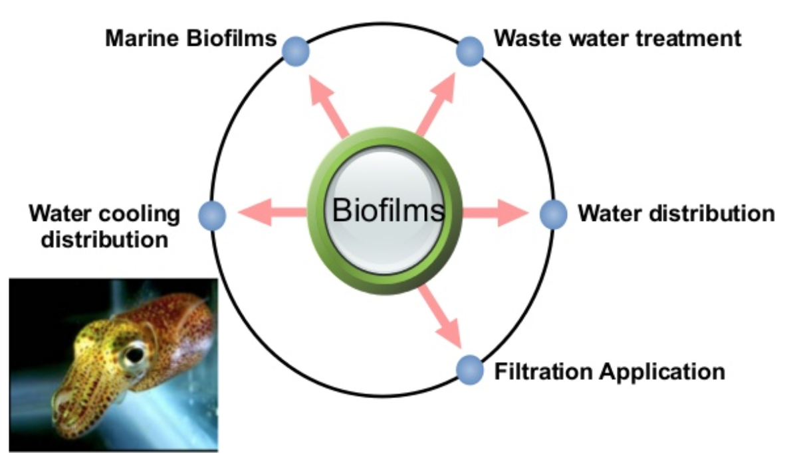
In industrial environments

Slide 59
Membrane fouling (Bio-fouling)
Undesirable build up of biotic deposit on surfaces (membrane)
Occurs:
On the surfaces of living marine organisms
In membrane systems such as membrane bioreactors
In cooling water cycles of large industrial equipment and power stations
In groundwater wells
In the exterior and interior of ocean-laying pipes.

Slide 60
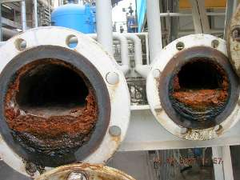

Biofilm effect in water system

Slide 61
Effect of biofilm in pipeline water distribution
Affect turbidity
Red (iron) and black (manganese) in H₂O
Increased frictional resistance
Pipe corrosion
Decreased aesthetic quality
Failure to meet water quality criteria

Slide 62


Slide 63
Microbe-metal interactions
Unfavourable interactions include transformation and mobilization of toxic metals and corrosion.
Within the water distribution system, a number of toxic metals are likely to be present, including lead from old piping and solder, copper from piping, zinc from corrosion inhibitors and other components from steel piping, fitments and weldments.

Slide 64
Three processes can be considered of paramount importance.
Interaction between bacterial cell walls and metals
Interaction between bacterial extracellular materials and metals
Production of acids and other corrosive metabolites.

Slide 65



Bio-corrosion

Slide 66

Bio-corrosion
They promote corrosion of metallic surfaces
Accelerate the corrosion of the pipes themselves, and initiate degradation of submerged objects such as offshore oil rigs, boats and shoreline installations.

Slide 67
When water comes into contact with metal piping and O₂ is introduced, microorganisms attach themselves to the metal surface and form a biofilm composed of bacteria, algae and other microorganisms.
This type of corrosion is called Microbiologically Influenced Corrosion (MIC)
MIC can spread so quickly and cause pinhole leaks in piping that lead to inefficiency, poor performance and ultimately, failure of a system.

Slide 68
Bio-corrosion
Responsible for off-flavours;
Discoloured water;
Harbour pathogens such as Legionella species;
Increase the chlorine demand and provide a site/sites for the regrowth of coliforms.

Slide 69

Tubercle formation
Tubercles develop from chemical or biological deposition of iron and manganese oxides to form deposits or concretions on a metal surface
These deposits may block flow within the pipe and may substantially reduce efficiency and discolour the water

Slide 70
Microbial deterioration of wastewater systems and other concrete structures
Major city sewerage systems (concrete) have been very badly damaged by acid deterioration, often known as sewer crown corrosion
The microbiology is dependent on the Sulphur cycle

Slide 71


Sewer crown corrosion

Slide 72
Sewer crown corrosion
CO₂ and H₂S (products of sewage decomposition) react with the damp concrete surfaces to form carbonates and calcium sulphate. As a result the surface pH of the concrete drops from approximately 12.5 to about 8.5.
Hydrogen sulphide is partially oxidized in air to form thiosulphuric and polythionic acids. These in turn lower the pH further to approximately 7.5.
Below pH 10 a number of different bacteria oxidize thiosulphate and polythionates to sulphate.
The pH continues to decline and at about 5, Thiobacillus thiooxidans oxidizes elemental sulphur to sulphuric acid. The final pH can reach 0.6 (Acidic)

Slide 73
Biofilms in water supply systems
Interactions between anthropogenic and natural systems result in the development of unique microbiological ecosystems
E.g. Iron tubercle formation on water distribution and cooling pipes and the corrosion due to sulphur in concrete sewers.
The common denominator is the use of source water

Slide 74
A source water (fresh, brackish, or marine), contains a community of bacteria, fungi, protozoa, algae, and higher invertebrates that initially contaminate and may thrive in the anthropogenic system.
The implications of this initial contamination include:
Natural microbial population development in piping systems, storage tanks and cooling systems etc., may result in biofouling, odour problems, health risks and bio-corrosion (direct consequences of microbial film formation on the surface of pipes)

Slide 75
Biofilms and Human Health
Bacterial cells within biofilms are controlled by the immune system
Contamination of medical devices
Artificial surfaces such as medical implants = sites for development of biofilms containing pathogenic microorganisms
Major source of nosocomial infections
Responsible for over 65% of infections treated in the developed world

Slide 76

Human Health

Slide 77

Medical implants
Medical devices implanted in the body:
Catheters: tubes used to conduct fluids in or out of the body
Prosthetic devices

Slide 78

Dental plaque
A yellowish biofilm that builds up on the teeth
The microbial composition changes from one that is primarily gram-positive to a structure filled with gram-negative anaerobes
Microorganisms that form the biofilm are almost entirely bacteria (mainly Streptococcus mutans, S. mitis, S. sobrinus)
Anaerobes include Fusobacterium and Actinobacteria

Slide 79
Biofilms are also present on the teeth of most animals as dental plaque, where they may become responsible for tooth decay and gum disease
Dental plaque is biofilm (usually of a clear color) that builds up on the teeth
If not removed regularly, it can lead to dental cavities (caries) or peridontal problems (such as gingivitis)

Slide 80
Factors:
The shape of the teeth is important.
Dogs are highly resistant to tooth decay because the shape of their teeth does not favor retention of food.
Diets high in sugars are especially cariogenic(causing tooth decay) because lactic acid bacteria ferment the sugars to lactic acid, which causes decalcification(softening of bone due to removal of calcium ion ) of the enamel of the tooth. Once breakdown of the hard tissue has begun, proteolysis (breakdown of protein into smaller polypeptides or amino acid) of the matrix of the tooth enamel occurs through the action of proteolytic enzymes released by bacteria.

Slide 81
Two microorganisms that have been implicated in dental caries are:
Streptococcus sobrinus and S. mutans, both lactic acid producing bacteria.
S. sobrinus is able to colonize smooth surfaces because of its specific affinity for salivary glycoproteins and this organism is probably the primary organisms involved in decay of smooth surfaces.
S. mutans is found predominantly in crevices and small fissures

Slide 82

Improper removal of plaque causes a build up of calculus (dark yellow color) near the gums on almost all the teeth.

Slide 83

Eye and biofilms
Contact lenses and contact lens storage cases
Intraocular lenses
Suture material

Slide 84


Biofilms – Food industry

Slide 85





Slide 86





Slide 87


Health risk assessment
Production sites
Health problems
Malaria (95%)
Skin rashes and foot rot (50%)
Diarrhoea (10%)
Observed unhygienic practices
Lack of protective equipment
Walking through irrigation
water channels

Slide 88
Food Industry
Biofilms are found on food processing vessels etc., where the bacteria adhere tenaciously(tending to keep a firm hold of something ) resisting removal by washing and also gaining protection from the common disinfectants, which cannot easily penetrate the polysaccharide matrix.
Biofilms on floors and counters can make sanitation difficult in food preparation areas

Slide 89
Biofilm Issues
Protection from washing and sanitization
E. coli- 2400x more resistant to chlorine in biofilm
Bacteria more resistant to removal by washing
Inclusion in a biofilm appears to select for bacterial phenotypes more resistant to biocides.

Slide 90
Petroleum Industry
Biofilms can help eliminate petroleum oil from contaminated oceans or marine systems
The oil is eliminated by the hydrocarbon-degrading activities of microbial communities, in particular by a remarkable recently discovered group of specialists, the so-called hydrocarbonoclastic bacteria (HCB)

Slide 91

Visualisation of Biofilms
Confocal laser scanning microscopy used to determine the location of GFP E. coli painted onto lettuce
Other enteropathogens can be examined
Other methods: eg Molecular-based methods
GFP E. coli on Lettuce observed using confocal laser scanning microscopy

